Slide 1
RF
Acceleration
RF Systems
C. Ohmori
KEK

Slide 2
Contents
RF Acceleration
Direc tvoltage and RF accelerations
  Electrostatic accelerators: Cockcroft&Walton, Van de Graaf
  RF accelerations: Linac, synchrotron(+FFAG)
Electron and Proton/ions
  β=1 vs. β<1
  Cavities (high-Q, ferrite, MA)
Beams
  Synchrotron motion
  Phase stability & transition
  Dual harmonic acceleration
  beam loadings
RF Systems
Cavities
  Designing of MA Cavities
LLRF
FFAG cavities

Slide 3
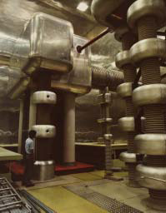
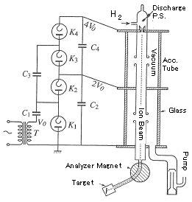
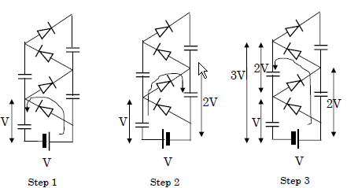
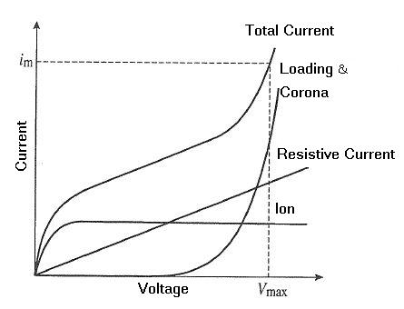
1.1 Direct voltage and RF accelerators
Electrostatic accelerator
Voltage is limited to 10MV because of corona discharge.
KEK 12 GeV PS

Slide 4
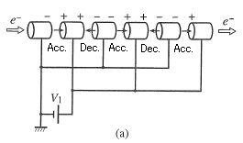
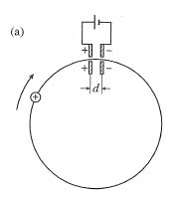
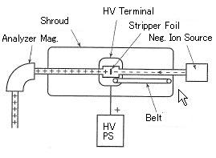
Static accelerator can not be combined with other static accelerators.
Idea of Tandem accelerator (2V)
Question: If static acceleration is applied to a circular accelerator, what happens ?

Slide 5
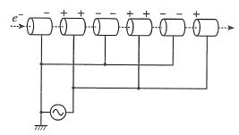
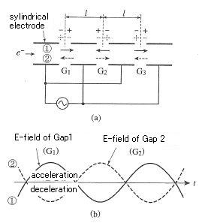
RF acceleration
Direction of RF voltage changes regularly.
RF field can be confined in RF structure (cavity).
1928 Wideroe K+, N+
1931 Sloan, Lawrence Hg+ (10 MHz RF )
1937-45 Hansen, Varian Klystron
1945- Alvarez 200 MHz Linac(DTL)
1947- disk-loaded linac 2856 MHz
1965 Wilson superconducting linac
⇒Long tubes
⇒Higher Energy

Slide 6
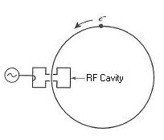
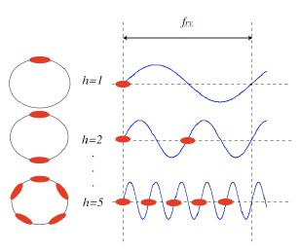
Circular machines
RF cavity (RF is confined in it).
frf=h frev
h:Harmonic number
Beam forms a bunch structure.

Slide 7
RF parameter of accelerators
Accelerators | Energy (GeV) | Circumference (m) | Revolution time(μs) | frev(MHz) | fRF(MHz) | H
J-PARC RCS | 0.18-3 | 348 | 2.1-1.2 | 0.47-0.84 | 0.94-1.67 | 2
J-PARC MR | 3-50 | 1568 | 5.37-5.23 | 0.186-0.191 | 1.67-1.72 | 9
KEK Photon Factory | 2.5 | 187 | 0.624 | 1.603 | 500.1 | 312
SP-8 | 8 | 1436 | 4.79 | 0.209 | 508.6 | 2436
SP-8 booster | 1-8 | 396 | 1.32 | 0.757 | 508.6 | 672
KEK-B | 3.5,8 | 3018 | 10.1 | 0.099 | 508.9 | 5120
J-PARC : proton machines
Others: electron machines

Slide 8
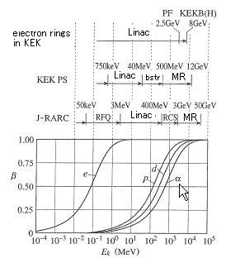
1.2 Electron and proton accelerations
Mass
  Electron: 0.511 MeV
  Proton: 938 MeV
In electron machines (E>10 MeV), β~1
For proton, E>20 GeV to be β~1
For many electron linac, fixed cavity structure.
For many proton linac, need to change structure according to acceleration.
For many electron rings, fixed rf frequency.
For many proton rings, need to change rf frequency.

Slide 9
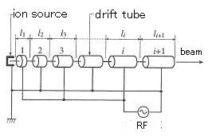
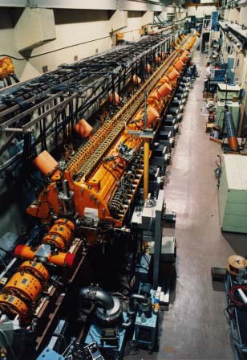
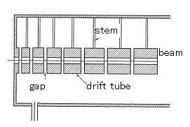
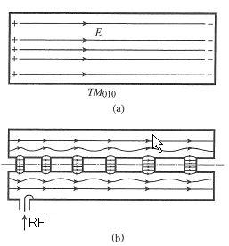
Proton linac needs to change length of drift tube according to acceleration.
R. Wideroe-type linac
Below 10 MHz, in a glass
li=βλ/2
Over 100 MHz RF high power sources become available after WWII. High energy acceleration became possible.
Particle | E(MeV) | β | βλ(200MHz) | βλ(3000MHz)
P | 0.75 | 0.04 | 6 | 0.4
P | 10 | 0.14 | 22 | 1.4
P | 100 | 0.43 | 64 | 4.3
e | 0.1 | 0.55 | 82 | 5.5
e | 1 | 0.94 | 141 | 9.4
e | 10 | 0.999 | 150 | 10.0
e | 100 | 0.99999 | 150 | 10.0
Alvarez linac (DTL) in KEK PS
About 200 MHz, cavity structure
TM(Transverse Magnetic)010 mode
li=βλ

Slide 10
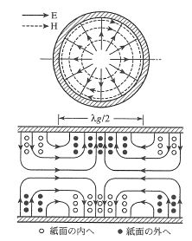

Electron linac uses a fixed structure and higher frequency.
  Alvarez type does not fit as β=1 and drift tube becomes long.
TM01 mode is used.
For multi-cell structure, traveling wave type cavity is used.
  Standing wave type has higher shunt impedance, but difficult for multi-cell.
TM01
TMmnp
m: circumferential
n: radial
p:longitudinal
TM010:Only longitudinal E-field
TM01 : Simplest mode in waveguide
Putting discs for slow-wave structure.
Phase velocity of RF matches velocity of electron

Slide 11
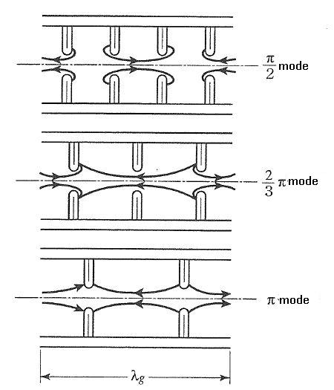
Acceleration Mode
m (disc/wave length) | λ (wave length) | 2π/m (phase /disc)
2 | 2d | π
3 | 3d | 2π/3
4 | 4d | π/2
2 π/3 mode has a large shut impedance.

Slide 12

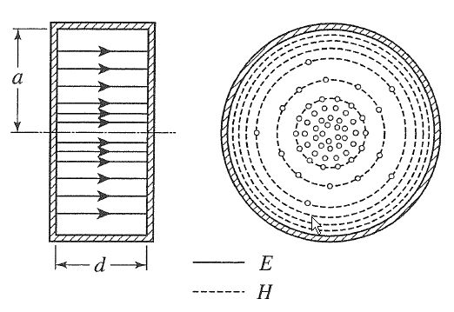
Cavity for Electron ring
Fixed frequency
same structure as linac cavity
But,
Low voltage because of high duty
Standing wave type cavity for high shunt impedance
Pill box cavity
TM010 mode is excited.
Resonant frequency is
independent on d.
To resonate at 500 MHz, a = 0.2295 m
Toresonate at 18.1 MHz, a =6.347 m

Slide 13
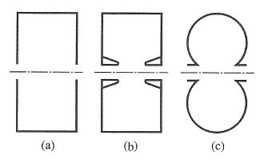
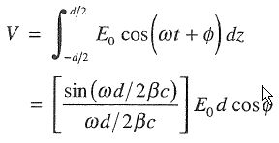


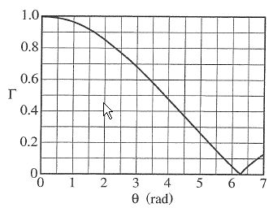
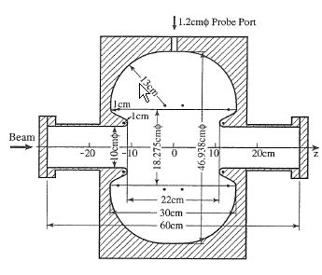
Transit time factor
E field which particle sees
d
d
(a)Pill box
(b) With nose cone
large Γ
(c) Curved surface
High shunt impedance
KEK-PF cavity
Original design

Slide 14
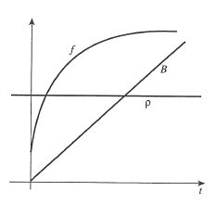
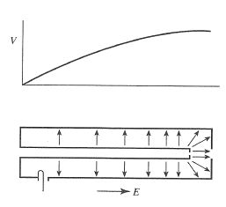
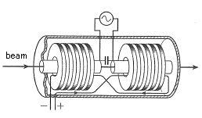
Cavity for Proton/Ion ring
Proton synchrotron needs to change RF frequency according to acceleration.
λ/4resonator
Ferrite cavity needs bias circuit to tune cavity.

Slide 15
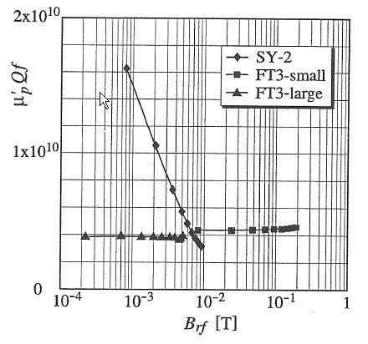
Magnetic Alloy Cavity
Stable μQf at high RF field
Low Q (frequency sweep w/o bias circuit)
High Curie temperature
μQf and Brf
are proportional to
shunt impedance and RF voltage

Slide 16
MA cavities
Q-value
Low Q (~0.6)
  CERN LEIR cavity
Hybrid cavity
  With external inductor Q~2
  J-PARC RCS
Cut core cavity
  High Q
  J-PARC MR
Cooling
Air
  PRISM cavity, (EMMA MA cavity)
Forced air
  PS booster cavity, many MA cavities for medical use
Indirect water cooling
  Gunma U. medical acc.
Direct water cooling
  J-PARC RCS&MR, LEIR cavities
Oil/Fluorinate cooling
  KEK PS 2nd H cavity
  KEK induction cavity

Slide 17
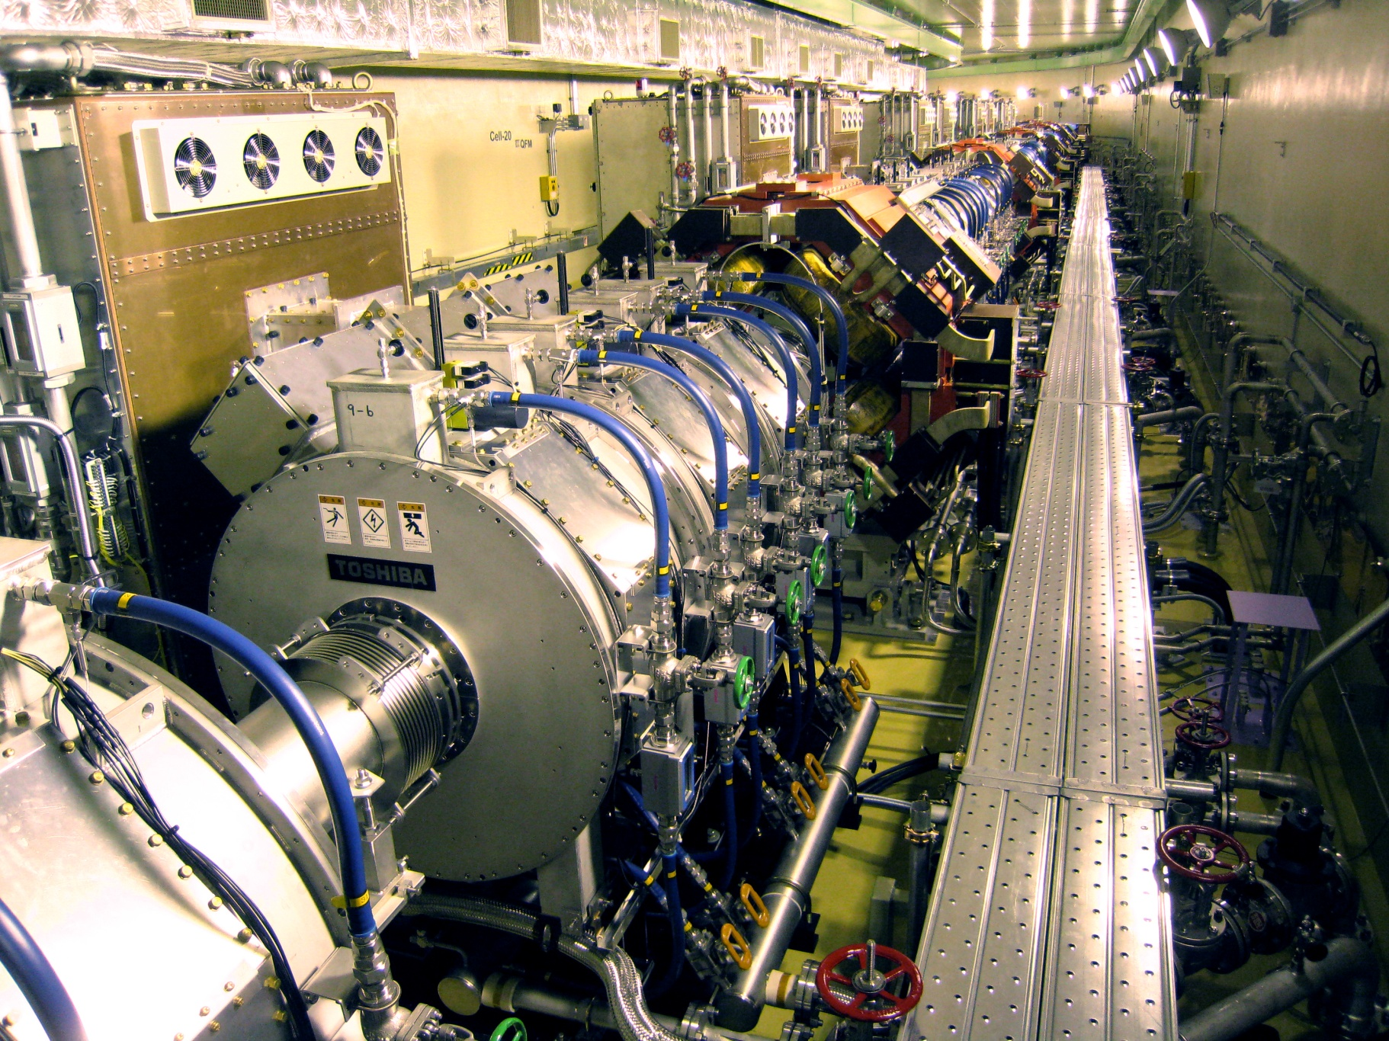
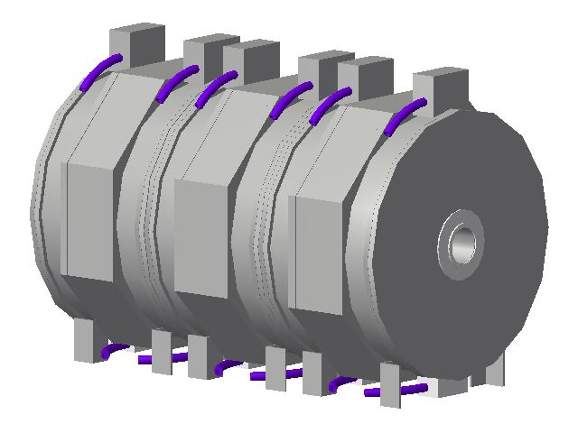
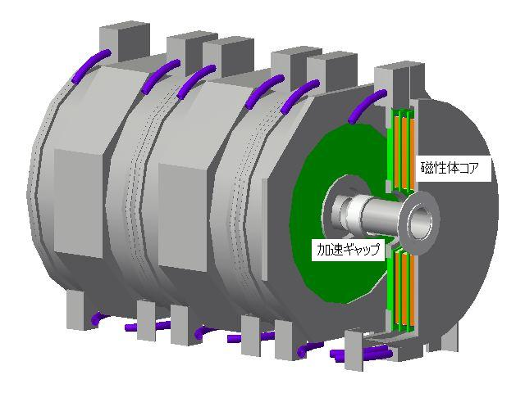
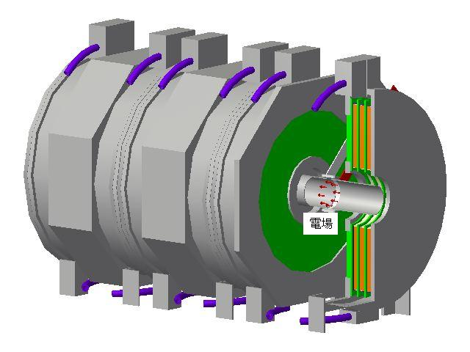
11 RF system for RCS

Slide 18
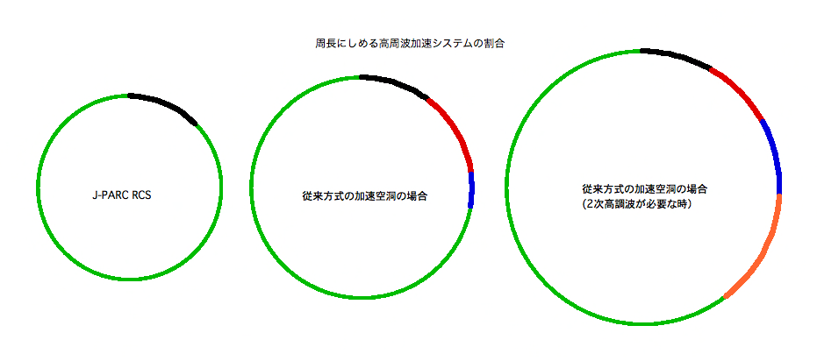
Impact on RCS design by
High Field Gradient
Length for RF in Ring
Ferrite cavity
With 2nd Harmonics
Ferrite cavity
Left: J-PARC RCS has about 350 m circumference. Black line means the space for RF (44 m, including Q-magnets).
Middle: 3 GeV Ring using ferrite cavity. Red line means additional space by low gradient. Blue is by the extended circumference.
Right: 3 GeV ring using ferrite cavity with 2nd H system (orange).

Slide 19
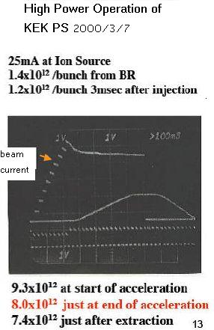
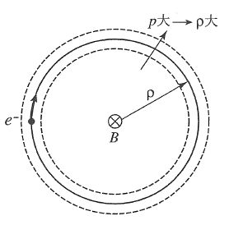
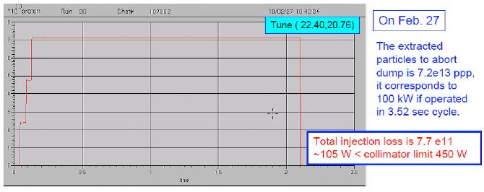



RF acceleration in Ring
Large p ⇒large ρ
When α-1/γ2=0, it is “transition”.
transition gamma
Electron ring does not have it as g is much larger than transition gamma.
In proton rings,
KEK PS : γt=6.76
AGS : γt=8.3
FNAL MI :
It is a source of beam loss.
J-PARC has no transition.
Momentum compaction factor
Slippage factor

Slide 20
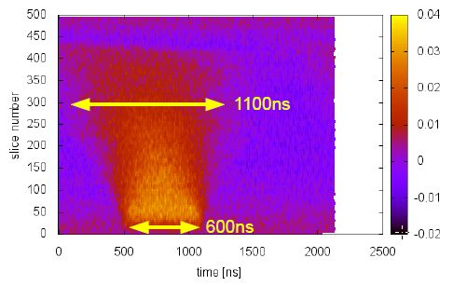
Slippage factor
Momentum spread (Full width) is given by
In RCS, h=-0.69, frev=0.469 MHz at injection.
Bunch is lengthen by 500 ns in 300 turns.
Momentum spread (full width) is 0.11 %
Contour plot shows
de-bunching of beam in RCS.

Slide 21
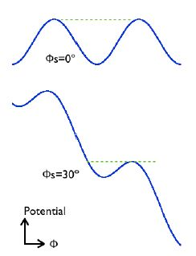
Synchrotron motion
Synchrotron motion
  Synchronous particle
  Non-synchronous particle
Equations
give
For small amplitude,
Synchrotron oscillation

Slide 22
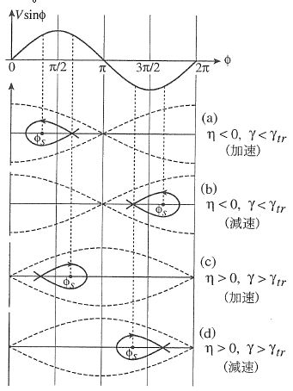
Stable RF phase
for stability.
Below transition, (η<0)
Acceleration
Deceleration
Above transition, (η>0)
Acceleration
Deceleration
At transition crossing,
RF phase φs will move to π−φs

Slide 23

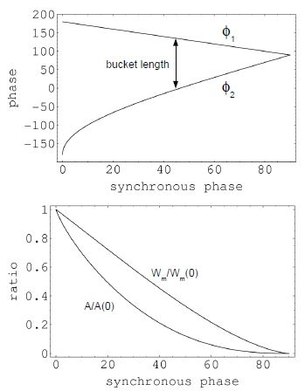
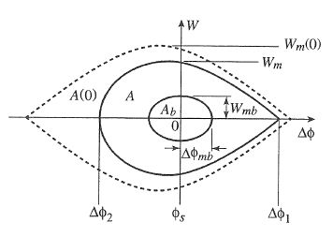
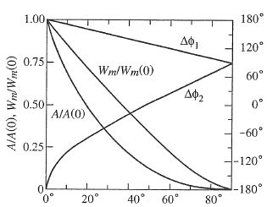
RF Bucket
Bucket height, Wm and Acceptance, A
for moving bucket
Particles are oscillating in the bucket.
Bucket height and acceptance for stationary bucket
When acceleration starts, φs is increasing, then Wm and A reduced.
Large RF voltage is necessary to accelerate high intensity beam.

Slide 24
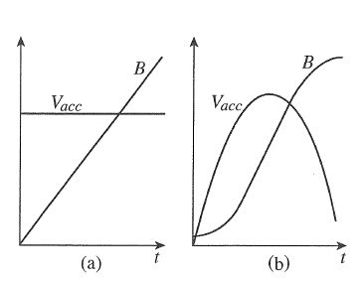
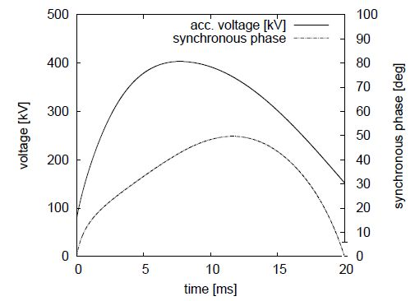
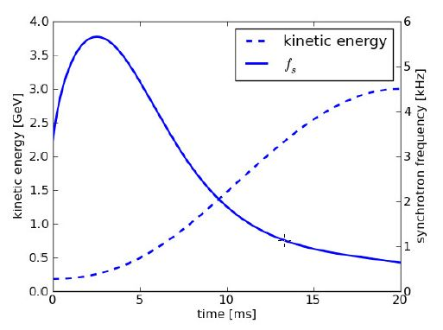
RF voltage pattern for proton ring
In proton synchrotrons, bunch length is gradually shortened by adiabatic damping. Momentum spread is increasing and emittance is constant.
In electron ring, synchrotron oscillation is damped by synchrotron radiation. But, the radiation also excites the particles. Emittance is given by two effects.
In proton ring, emittance matching is important as no synchrotron radiation.
(a): dB/dt = const
(b): RCS
A computer code, RAMA, is suitable to estimate the bunch size and energy spread during acceleration from magnet pattern.
  Developed by Rick Baartman, TRIUMF.
The emittance given by a booster accelerator can be used for another accelerator (Main Ring).
It also gives longitudinal beam impedance and instability effects.
Hoffman-Pedersen distribution is used to estimate the longitudinal space charge.

Slide 25
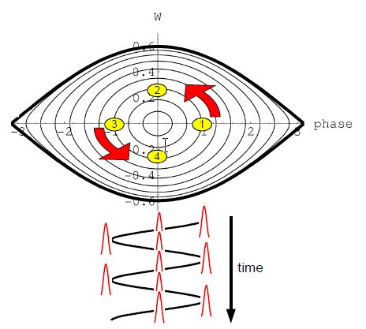
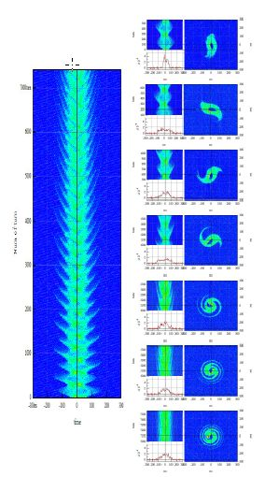
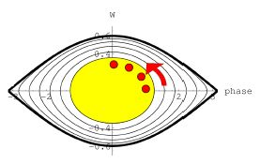
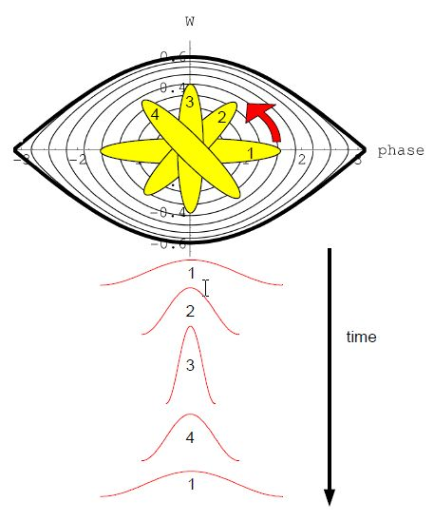
Motion of particles
If bunch is matched to
rf ucket, dipole and quadrupole oscillations will not be excited .
If it is not matched, filamentation and emittance growth occur.

Slide 26
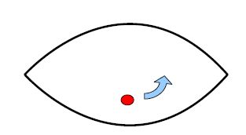
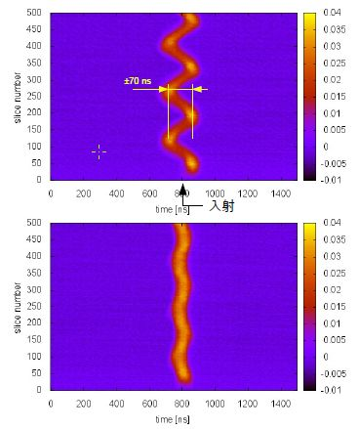
Way to adjust RF frequency to initial energy
When bea was injected to RCS, dipole oscillation was observed. It suggests, rf frequency is high. The frequency was reduced to 938175Hz from 939471Hz to match.

Slide 27



Dual Harmonic RF
Dual harmonic AVC
As tuning-circuit is not used for cavity, MA cavity is assumed a passive circuit.
But, impedance at injection is much smaller than that at extraction. AVC gain is changed during acceleration.
In case of ferrite cavity, two different RF system have to be handle.
Dual harmonic RF voltage (red)

Slide 28



Space charge effects
Dual Harmonic is a powerful tool to reduce the space charge effects.

Slide 29




Effects on beam

Slide 30

High intensity beam
To accelerate high intensity beam,
  Beam loading on RF sys.
  Space charge effects
  Instability
  others
should be care.
Example of beam loading on RCS cavity.
300 kW beam is accelerated.

Slide 31



Beam loading
Assuming cavity is parallel circuit of LCR,
Phase of beam is 90 deg late from RF phase.
High Q system: a phaser of RF frequency
Low Q system : phaser diagrams for higher components

Slide 32




Direct Feedback
Feed forward
In case of ferrite system, tuning loop makes the system complicated.

Slide 33



Feed forward
10 cavities for acceleration,
1 for measuring wake voltage
Left FF OFF, Right FF ON
Gap voltage for each RF component
Upper FF OFF, Lower FF ON
Gap voltage
Right acceleration, Left Extraction
Upper w/o beam
Middle with 300kW beam FF OFF
Lower with 300 kW beam FF ON

Slide 34


Effects on beam
After 2 ms, h=4 and 6 show oscillation.
It is quadrupole (or higher).
Beam bunch becomes narrow
(emittance growth was reduced)

Slide 35
RF Systems

Slide 36

Proton Rings
Ferrite cavities
In hadron accelerators, velocity of particle changes (not β=1 as electron accelerators). When synchrotron was developed ferrite cavity was the most possible scheme to sweep the rf frequency.
Beam pipe
Ferrite ring

Slide 37

Ferrite cavity
HIMAC Ferrite Cavity & AMP
Courtesy of M. Kanazawa

Slide 38



Characteristics of ferrite

Slide 39







Ferrite Cavities
Single-End
Single gap
Push-pull
Single tube
Drift-tube

Slide 40

Magnetic Alloy cavity
MIMAS Cavity
Probably, this is the first MA cavity.
Courtesy of A. Schnase

Slide 41





Production of MA
①Amorphous→ | ②Ribbon→ | ③SiO2 Coating→ | ④Winding of large core→ | ⑤Annealing
Production of Ferrite Core
Ferrite powder with glue
Forming a ring core shape
High pressure press
Annealing
Polishing surface

Slide 42
Comparison
 | MA | Ferrite (Ni-Zn)
Saturation flux density | 1.2 T | 0.4 T
Possible Acc. Field gradient | High (25kV/m for J-PARC) (depend on duty factor) | Below ~15kV/m (depend on freq. and I.D.)
Permeability | ~3000 | ~500
Core impedance | Few 100 Ω/core | Few 100 Ω/core depend on voltage
Q-value | ~0.6 | Few 100
Bandwidth | Wide | Narrow

Slide 43
Designing of MA Cavity
 | High gradient | Medium gradient
Wideband | Un-cut core | Un-cut core
 | LEIR cavity AGS Barrier cavity | Gunma U. Medical machines
Medium | Un-cut + inductor
 | J-PARC RCS PRISM
Narrow band | Cut core
 | J-PARC MR EMMA MA cavity
Keys
  Bandwidth
  RF voltage
  Beam current

Slide 44

LEIR RF SYSTEM – RING SECTION
Free space is used for H=2 RF system, now.

Slide 45

Magnetic Alloy cores
（water-proof coating）

Slide 46

Bandwidth
Wideband uncut core cavity
Bandwidth (upper) is limited by floating and tube capacitances.

Slide 47
LEIR RF SYSTEM
Cavity Model: Half Cavity Z (1 Core )
Additional C:
0
+20pF
+40pF
+100pF
Response similar to that of an RC circuit.
Above cutoff the slope is mainly dependent on C value.
Structure capacitance is ~12pF.
M. Paoluzzi

Slide 48

Capacitance from AMP

Slide 49


Uncut + inductor for medium bandwidth

Slide 50



Control of Q-value w/o cutting
CAVITY DESIGN for High intensity
Parallel inductance reduces inductance of resonant circuit. Additional capacitor
Preferable Q-value for RCS, 2, for BL and dual H.
It is too high for uncut core and too low for cut core.

Slide 51




Cut Core Configuration for higher Q

Slide 52



Cut Surface
Bad polishing
Good Polishing

Slide 53


Slide 54

Cut Core cavity
Cut core cavity is used for
  Accelerator with transient beam loading + very short beam …………J-PARC MR
  Accelerator with high resonant frequency and narrow band ……….RIKEN beam chopper
High voltage and high power use requires a good cutting scheme to avoid destruction of ribbon insulation. Destruction of insulation of 2μm will cause local heating of cut surface.

Slide 55
Q-value of MA cavity
Core | Q | Frequency | Uses | Accelerators
Uncut core | ~0.6 | 300kHz-3MHz | Low energy, Ion synchrotron, Bunch manipulation | KEK PS booster, CERN LEIR, Medical use, AGS (Barrier bucket, Bunch Stacking)
Hybrid | 2- | Few MHz - | Medium energy High intensity w/o transient B.L. | J-PARC RCS
Cut core | 5- | Few MHz-(few 10MHz) | High energy High intensity with transient B.L., High frequency use | J-PARC MR, Riken beam Chopper

Slide 56




Cooling Scheme
Air | Low duty | <0.2 W/cc |  | AGS barrier Medical use | Simple
Forced Air | High duty | ? 0.5 W/cc |  | KEK PS booster
Indirect | High duty | < 0.5 W/cc |  | JHF R&D Medical use
Direct-water | High duty | 1 W/cc | Water | J-PARC MR, RCS | High power use
Direct-other | Low duty | ? | Florinate Silicon oil | KEK PS 2nd KEK PS induction | Good for higher freqeuncy

Slide 57



Materials
Materials | Impedance | use | Ribbon Insulation | Maker
Fe- amorphous | Low | MIMAS |  | VAC, Allied, Hitachi-Metal
Co- amorphous | High | Gunma Medical |  | Allied, Toshiba
Nano- crystalne | High | J-PARC, AGS, CERN, Riken | SiO2 2μm | Hitachi-Metal
New MA | Higher |  | SiO2 2μm
Ferrite | High at low voltage | Many
A large MA core using new material, FT3L,
Is under developing at J-PARC

Slide 58
RF System
MA Cavity
Ferrite loaded cavity
MA cavity
  Passive LCR circuit
Final stage AMP
  Wideband circuit, multi-H
  CG: all pass network
Driver AMP
  Few kW
Low Level RF
  Multi-H
  ALC, (phase, orbit), beam loading
Ferrite Cavity
  Bias PS for tuning cavity
Final stage AMP
  Narrow band
Driver AMP
  About 1 kW
Low Level RF
  Single H
  ALC, phase, orbit, tuning loop, beam loading

Slide 59

LLRF

Slide 60


Frequency tuning during acceleration (RCS)
B-field becomes stable after few days from restart.
Digital LLRF + MA cavity give a very stable RF system. (MA cavity is passive system)
Usually, orbit feedback is necessary for high intensity ring.
In RCS, orbit remain stable whole cycle after tuning.
Stability of orbit during high power test (300 kW). The time jitter is only 1.7 ns.

Slide 61


Phase feedback damps dipole oscillation.
Upto 100 kW beam, still phase feedback is not necessary for operation.
Above 300 kW, beam loading compensation using feed forward technique is necessary.

Slide 62
FFAG Cavities
MA cavities
  PoP, 150 MeV
  PRISM
  EMMA MA
EMMA cavities

Slide 63
FFAG cavities
Air cooling | PoP FFAG PRISM FFAG
Indirect water cooling | 150 MeV FFAG
Induction | Ion beta FFAG
Normalconducting RF | EMMA (non-scaling FFAG in UK)

Slide 64

Air-cooled uncut core cavity PoP FFAG cavity

Slide 65


Cavity assembly
150 MeV FFAG
Number of cores 2~4
Outer size 1.7m x 1m
Inner size 1m x 0.23m
RF frequency 1.5 - 4.6 MHz
RF voltage 9 kV
RF output 55 kW
Power density 1 W/cm^3
Cooling water 70 L/min
Indirect cooling

Slide 66


Air cooling

Slide 67

Cavity Design Parameters
Parameter | Value
Frequency (MHz) | 1300
Shunt impedance (MΩ) | 2.05
Q₀ | 20500
R/Q | 100
Tuning Range (MHz) | -4.0 to +1.6
Accelerating Voltage (kV) | 120 | 180
Power to generate voltage (kW) | 3.6 | 8.1
Power including overhead# | 4.7 | 10.5
# Includes Distribution losses and LLRF Control
1st September 2008
FFAG08 Carl Beard

Slide 68


EMMA MA CAVITY
frequency | 18 MHz | =1.3 GHz/72
frequency sweep | 3 %
df/dt | 97.2 GHz/s | Phase shift =π/37 turns
Total Voltage | 100 kV per turn | 100 turns/cycle
Number of cavities | 3
Voltage | 33.3 kV
Length of cavity | 10 cm
Number of MA cores | 2 per cavity
Size of MA core | 27 cm O.D, 12 cm I.D x 2.5 cm
MA core | Cut core
Q-value | About 9
Cavity impedance | 600 Ω (1.4 k Ω )
Core material | FT3M (FT3L)

Slide 69
Beam Acceleration in FFAG
Beam acceleration in Synchrotron
Pattern of frf is given by B field.
Required rf voltage is given by dB/dt and φs
Beam acceleration in FFAG
B-field is constant.
Scaling FFAG
Pattern of frf is given by energy gain; rf voltage and φs
Very fast acceleration in Non scaling FFAG
Constant rf frequency.
RF voltage is given by top and bottom energy

Slide 70
Summary
In this lecture,
RF Acceleration
RF System

