Slide 1
High Energy Muon Colliders
C. Johnstone and P. Snopok
Fermilab and UC Riverside
FFAG10
October 25-31, 2010

Slide 2
High Energy Colliders*
The physics:
  Hadron collider energies are limited by their size, and technical constraints (bending magnetic fields) – it becomes impractical to obtain the required luminosities, which must rise as the energy squared. Even worse, the gluon-gluon background radiation makes it increasingly difficult to sort out the complicated decay schemes envisaged for the SUSY particles.
  Lepton colliders in general, have the advantage that the interaction energy is given by twice the machine energy, and, because they undergo simple, single-particle interactions, - in a hadron collider, the effective energy is much lower than that of the proton.
  The lepton collider on the other hand oers clean production of charged pairs with a cross section comparable to σ_{QCD} =100/s fb where s is the energy squared in TeV² .
*
μ⁺- μ ⁻ Collider: a Feasibility Study, submitted to the Snowmass96 workshop proceedings.

Slide 3
The rationale for muons
Extension of e⁺e⁻ colliders to multi-TeV energies is severely performance-constrained by beamstrahlung, and cost-constrained because two full energy linacs are required to avoid excessive synchrotron radiation.
Muons (m_{μ}/m_{e}= 207) have negligible beamstrahlung, can reach much higher energy than e+e− colliders, and can be accelerated /stored in rings with a much smaller radius than a hadron collider of comparable energy.
The reduced beamstrahlung and initial state radiation leads to better energy definition of the initial state.
When coupling is proportional to the mass (the s-channel Higgs production), muons have an advantage of (207)² over electrons.

Slide 4
The technical challenges with muons
Muon decay with a lifetime of 2:2 x10⁻⁶ s.
Muons must be accelerated rapidly to outrace decay: at 2 TeV the muon lifetime is 0:044 s (sufficient for ~1000 storage-ring collisions).
Muon decay products heat the superconducting magnets of the collider ring and create significant backgrounds in the detector.
Muons are created through pion decay into a diffuse phase space, and must be captured and cooled; (conventional stochastic or synchrotron cooling is too slow for muon decay
Muon beams will remain larger than electron beams in an e+e− collider; smaller, more severe focusing is required for collisions
New technologies are required.

Slide 5
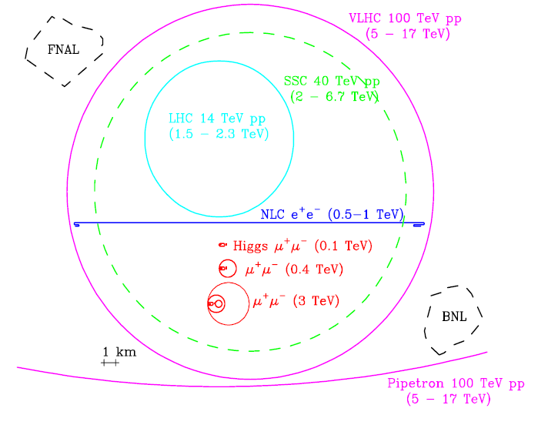
Collider comparisons
Comparative sizes of various proposed high energy colliders and FNAL and BNL sites. The energies in parentheses give for lepton colliders their CoM energies and for hadron colliders the approximate range of CoM energies attainable for hard parton-parton collisions.

Slide 6
Neutrino Factories
A Neutrino Factory provides both ν_{μ} and‾ν_{e} beams of equal intensity from a stored μ− beam, and their charge-conjugates for a stored μ+ beam.
Beams from a Neutrino Factory are intense compared to other neutrino sources, have smaller divergence and therefore permit the study of non-oscillation physics at near detectors, and the measurement of structure functions and associated parameters in non-oscillation physics to unprecedented accuracy.
NFs also permit long-baseline experiments that can determine oscillation parameters to unprecedented accuracy.
DIFFERENT PHYSICS, DIFFERENT MACHINE!!

Slide 7
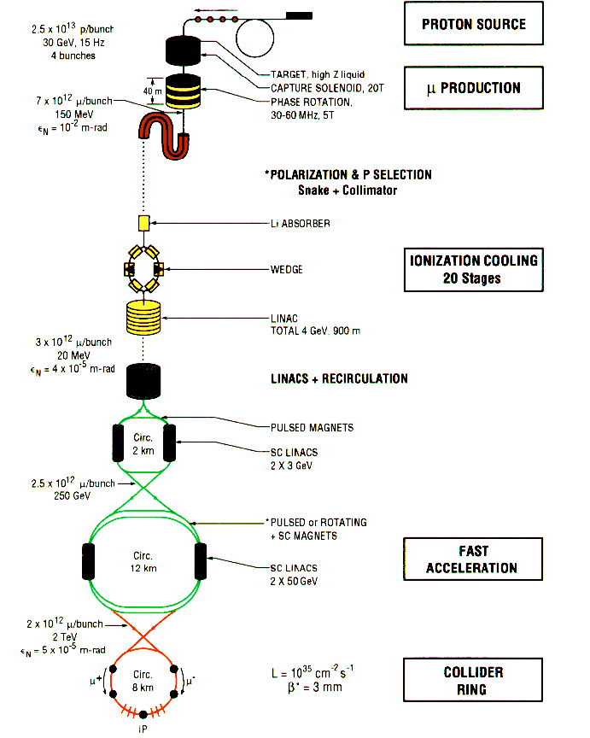
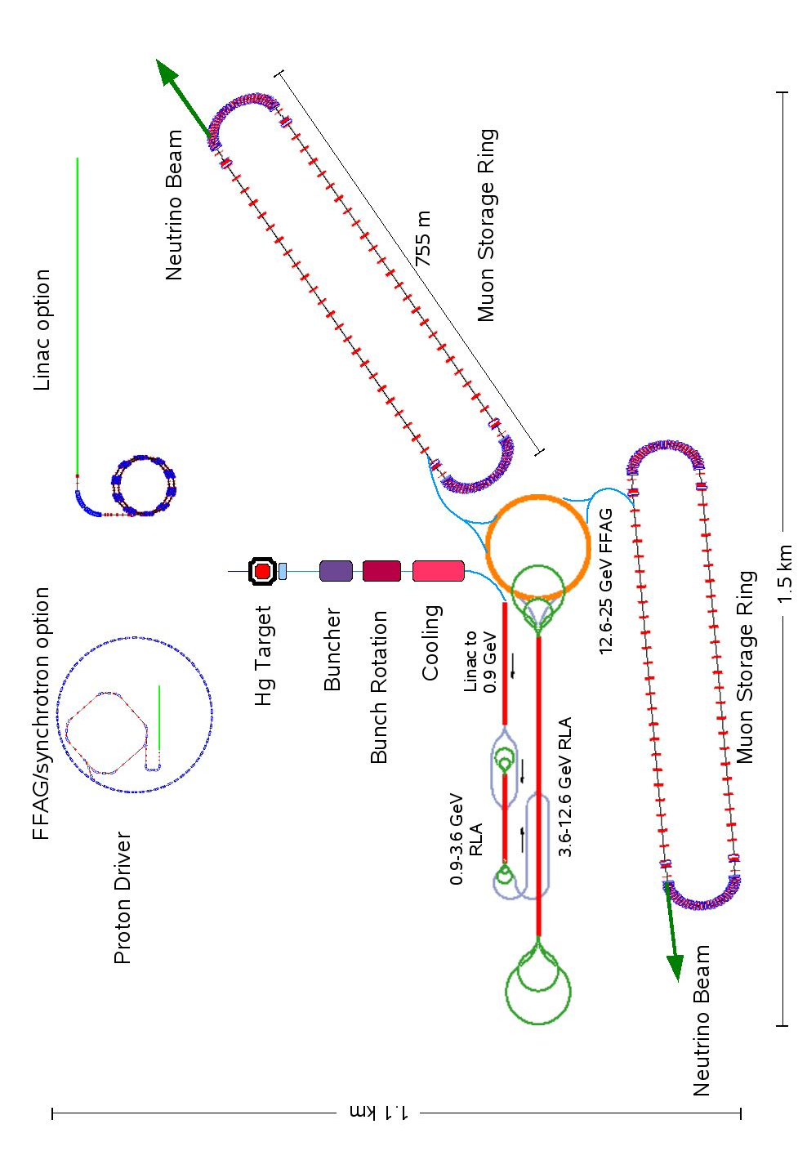
Early Collider and recent NF layouts

Slide 8
Muon Colliders and Neutrino Factories
The Collider
At least 1000x smaller emittances required, small momentum spread
Single circulating bunch of μ+ and also μ- in counter-rotating directions
Collision at a single point: Interaction Point (IP) in a specially designed insertion (Interaction Region, IR).
Maximize luminosity, minimum beam size, maximum divergence in IR
Neutrino Factory
In contrast: large emittances, large dp/p in circulating beam
Large beam, small divergences in long neutrino production (muon decay) straight
Bunch train; no collisions, μ+/μ- generally in the ring independently

Slide 9
Comments about RLAs vs FFAGs
FFAGs: Large emittances, longitudinal phase space distortion
  Does NOT apply to the collider due to much smaller emittances, multiple FFAGs can be the upstream accelerator system.
  Recent tune-stable designs may eliminate distortion for the NF.
RLAs capable of only 4 turns due to complexity of switchyard vs. 10-15 turns in a FFAG
  Transverse phase space blow-up issues (over full +/-10-20% momentum spread). This has not been properly tracked.

Slide 10
Muon Collider luminosity: General
The collider ring allows for (about) 1000 collisions per bunch, rather than the single collision that is possible in a linear collider geometry. If the transverse beam size at the collision = that in an electron-positron linear collider, there would be a full increase in luminosity of order 1000. This is not the case.
The muon bunch is cooled as much as possible, but still has an emittance that is significantly larger than the extremely low emittances in an electron-positron linear collider.
The luminosity scales as L = f N² / ((ε_{nx}β_{x})(ε_{ny}β_{y}))^{1/2},
where ε_{x(y)} is the beam emittance in the x(y) phase plane, β*_{x(y)} the corresponding beta-function at the interaction point (which is limited, by the hour-glass effect, to be no less than the bunch length), and f the collision frequency.

Slide 11
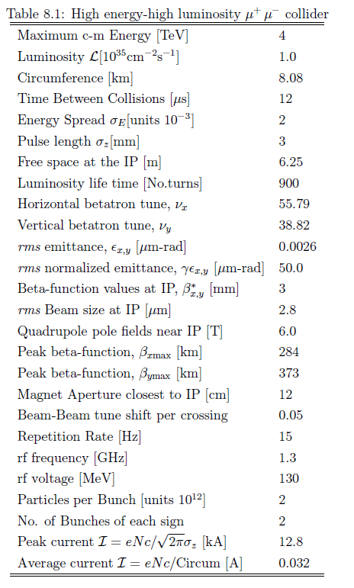
2x2 TeV Collider
Requirements
Luminosity: 10³⁵cm⁻² s⁻¹ for
2 TeV x 2 TeV.
  f = 2 x 1000 x 15 = 30,000 Hz
  (# bunches x # collisions x 15 Hz)
  N = 2x10¹² muons/bunch
  β*=0.003 m
  15Hz challenging, 2x10¹² muons/bunch really challenging

Slide 12
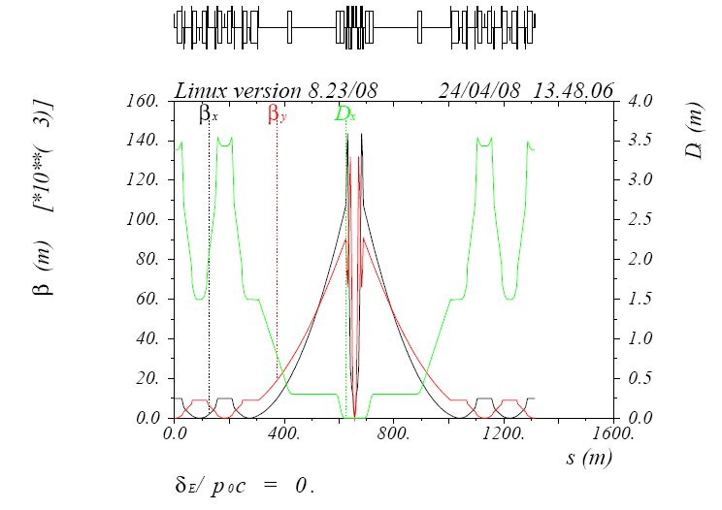
Achieving ultra-low 3 mm beta IP
6 m drift is required for the detector
Local chromaticity correction
is required, change in tune
as a function of momentum:
ξ ∝ β kl
where k and l are the strength
And length of a quadrupole,
respectively
β _{Max} scales with 1/β*

Slide 13
Chromaticity of Muon IRs
β*= 3 mm, ξ ~ -2,000 (vertical)
β*= 1 cm, ξ ~ -666
For comparison the LHC IR (β*= 0.5 m) has a chromaticity of ~60.
No colliders are currently operating at such low β*s.
This high a chromaticity cannot be corrected in the arc – no off-momentum stability

Slide 14
Chromatic correction
Sextupoles in –I pairs on either side of the IR quads.
Dispersion causes off-momentum beam to travel off the reference trajectory; in a sextupole there is a quadrupole feed-down for off-axis beam:
B ∝ x²; B’∝ x
The “local” gradient increases / decreases with offset and therefore high / low momentum relative to the central momentum
However, this also means that as the particle amplitude increases, the gradient and phase advance also change known as a tune-shift-with-amplitude; this is countered using sextupole in 180° pairs.
180°
2nd kick cancels first relative to center
Kick, relative to center

Slide 15
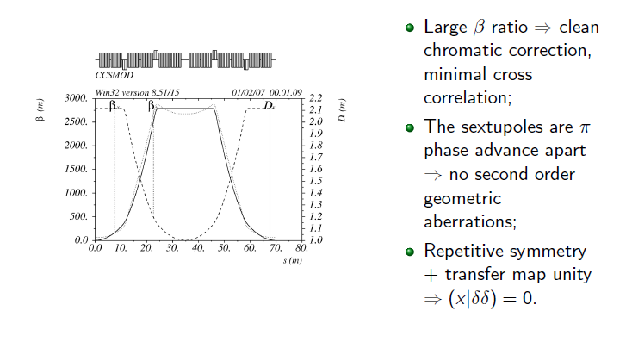
Chromatic Correction section
Large β ratio allows interleaving of horz/vert sextupoles for compactness

Slide 16


Isochronous condition for Collider
In order to have very short 3mm bunches in the 2 TeV muon collider, the storage ring must be quasi-isochronous, which requires that the momentum compaction be very close to 0, where α is defined in terms of the offsets of the momentum p and equilibrium orbit circumference, C, by
To first order the time difference with respect to the reference particle is given by
where T₀ and α₀ are the revolution period and momentum compaction of the reference particle, ΔT and Δp are the time and momentum deviations, respectively, of the off-momentum
particle relative to the synchronous particle with momentum p₀; η is the phase slip factor; γ is the Lorentz relativistic factor, and α₀ = α(p₀).

Slide 17
Isochronous condition continued
In an isochronous ring η = 0, so to first order the arrival time is independent of the momentum; i.e., γ _{t} = γ. The collider operates at transition.
For 2 TeV muons γ≈2 x10⁴; so α≈ 2.5 x10⁻⁹
To bring the first order value of α to zero requires that the ⟨D/ρ⟩=0 through all of the dipoles be equal to zero, where D is the dispersion and ρ the radius of curvature.

Slide 18
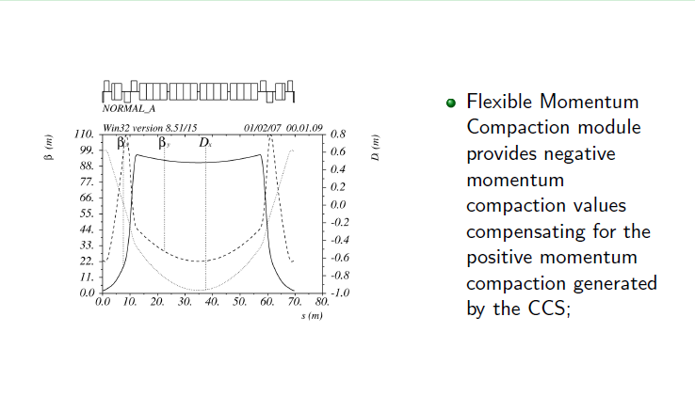
Momentum compaction in the Collider arcs

Slide 19
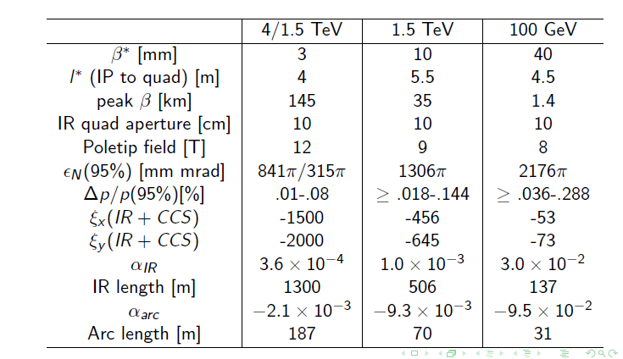
Basic parameter comparisons for different designs and β*

Slide 20
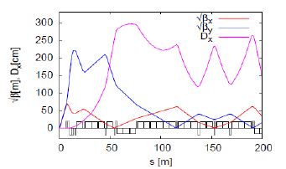
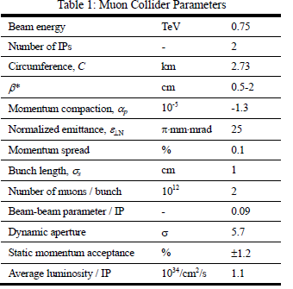
Recent Collider design work:
Y. Alexahin and E. Gian-felice
Borrows heavily from
Oide design where β_{y}>> β_{x}; hence
Chromaticity is large in one plane
only.
The approach and
correction scheme is detailed in
IPAC10 papers:
tupeb021/tupeb022
Has achieved required DA and
Momentum stability

Slide 21
Summary of current collider work
Complex correction scheme to achieve required performance.
No quadrupole fringe fields in simulation
  This has always been devastating
  No confidence that existing lattices will survive
  Asymmetric emittances are being investigated.

