Slide 1
June 13th experiment
D. Kelliher, 18/6/2019
19/6/2019 update

Slide 2
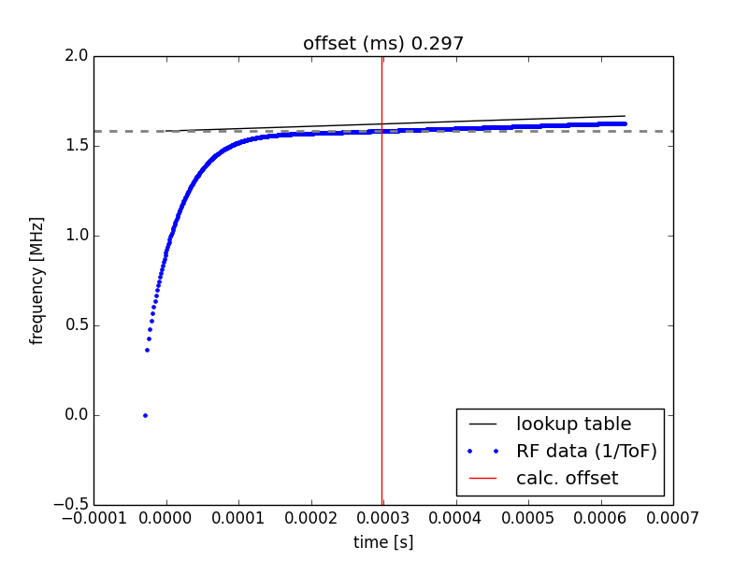
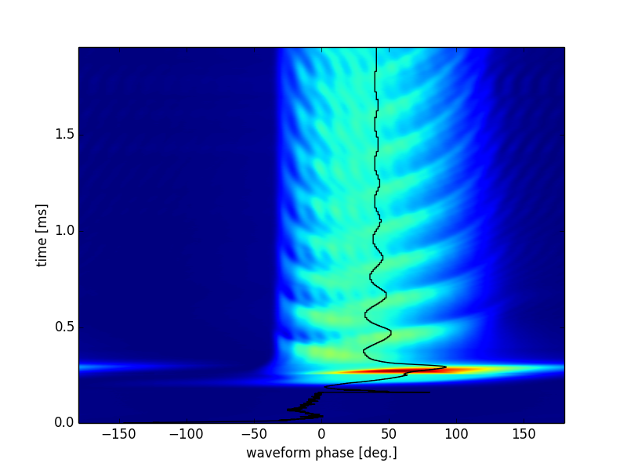
Injection time

Slide 3
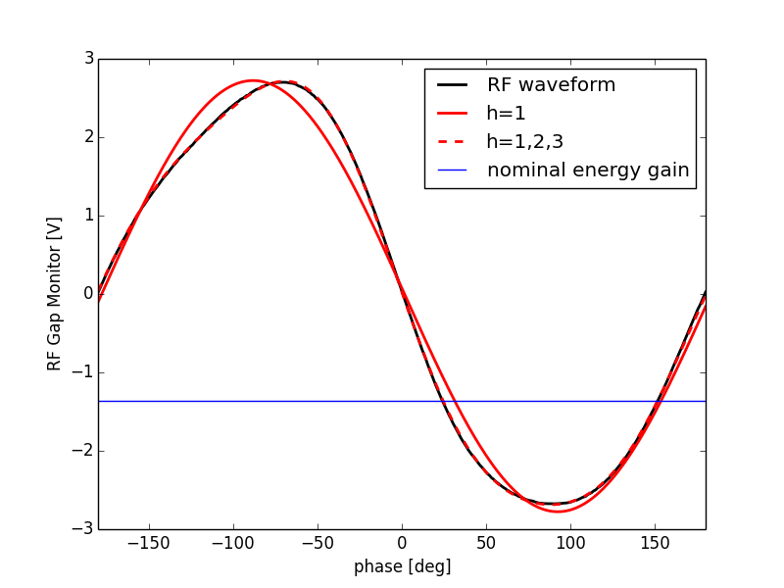
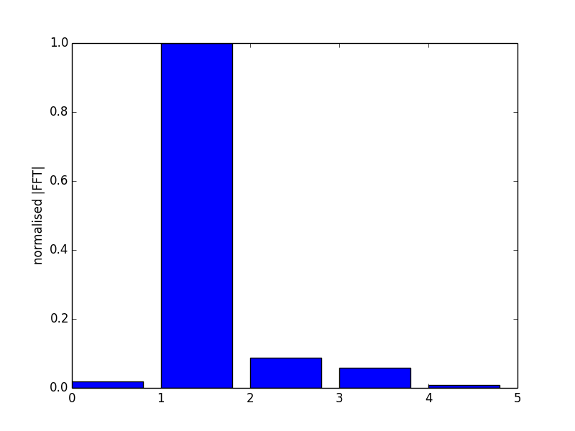
RF waveform – harmonic components.
RF voltage amplitude = +/- 2.69kV assuming a gain of x1000.
Assuming this voltage and a fixed energy gain 4*sin(20 deg) – the synchronous phase is 30.57 deg (ignoring multi-harmonic effects).
Based directly on the measured waveform the synchronous phase is about 24 degrees.

Slide 4
Data list
Experiment number | Phase jump | Scope time limit | Scope time res [ns]
0 | 0 | 2ms | 2
1 | 20 | 2ms | 2
2 | -20 | 2ms | 40
3 | -20 | 20ms | 40
4 | 10 | 2ms | 2
5 | 10 | 20ms | 40
6 | 0 | 20ms | 40
7 | 20 | 20ms | 40

Slide 5
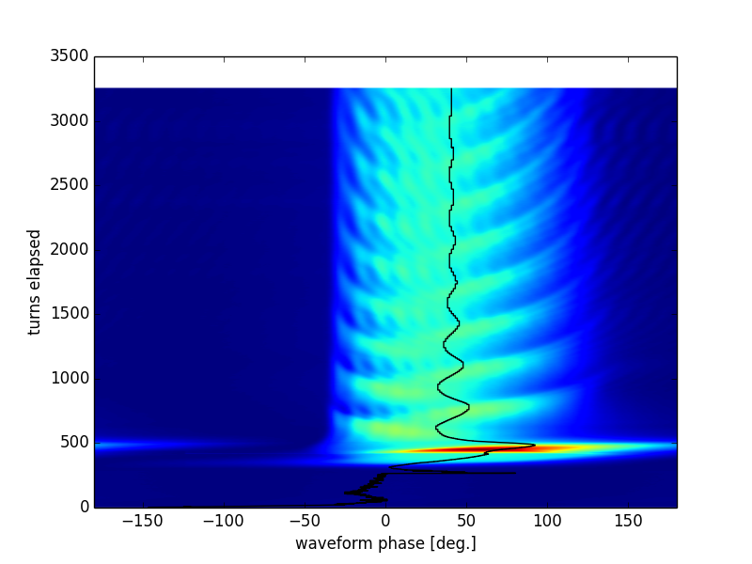

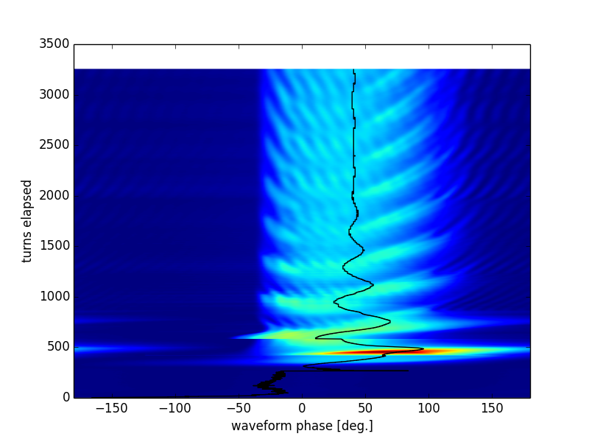
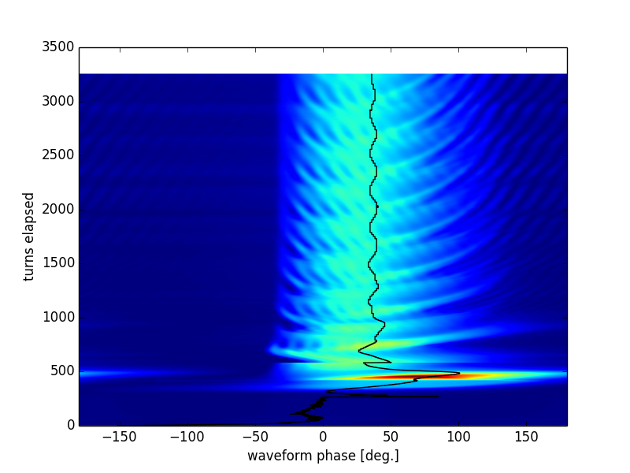
10 deg
0 deg
High resolution data
-20 deg
20 deg

Slide 6
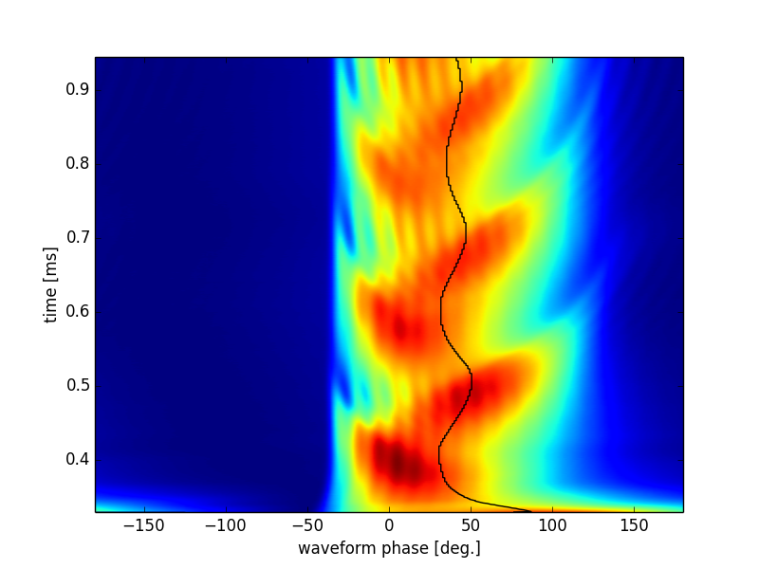
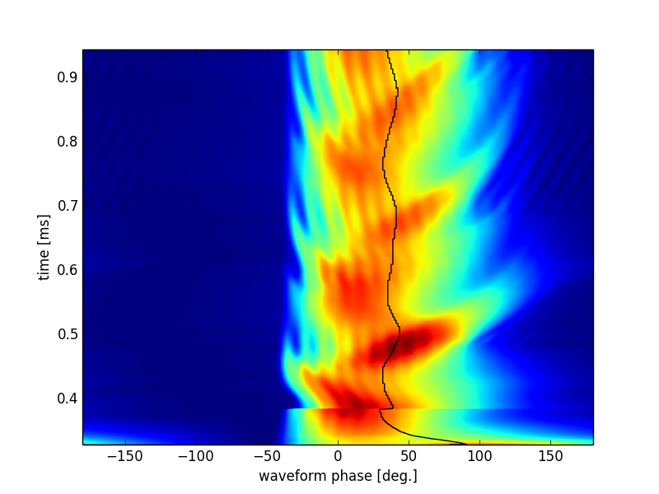
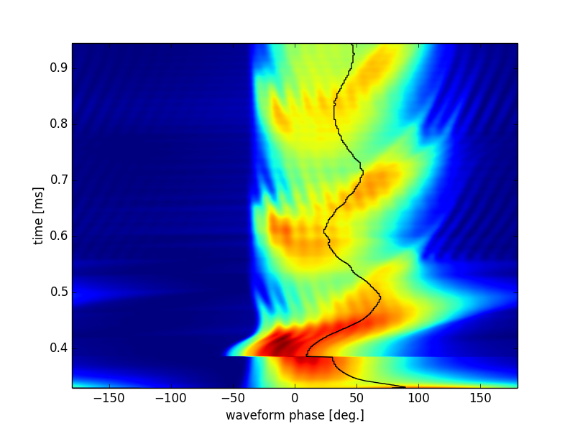
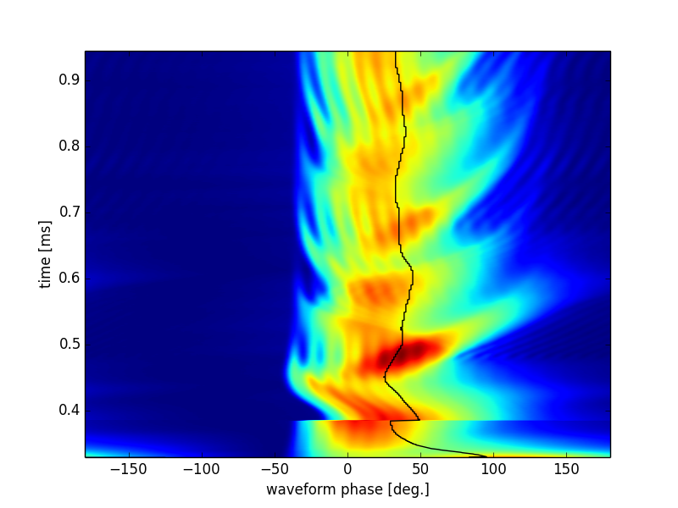
10 deg
0 deg
High resolution data (from 0.33ms)
-20 deg
20 deg

Slide 7
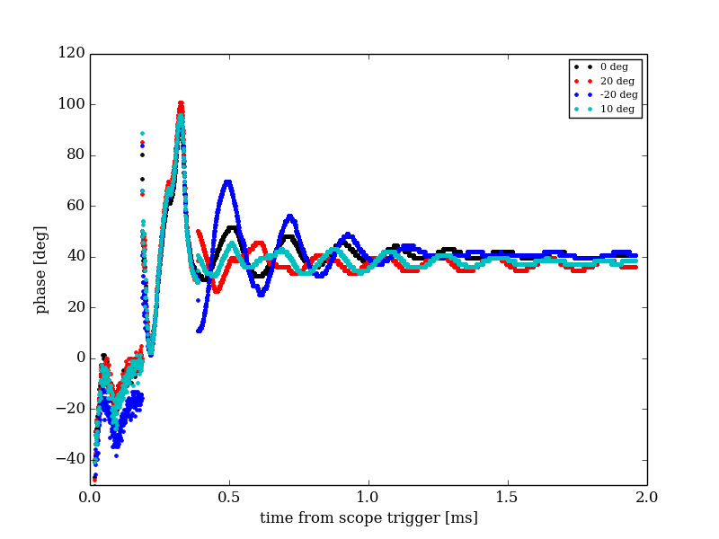
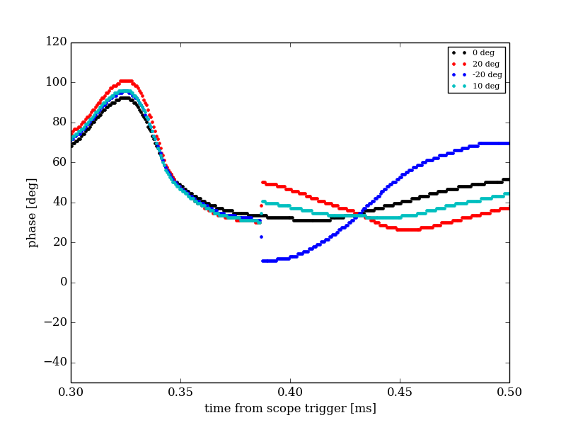
Symmetric phase
Phase jump
Zoom around phase jump
“Symmetric phase” is found by minimising

Slide 8
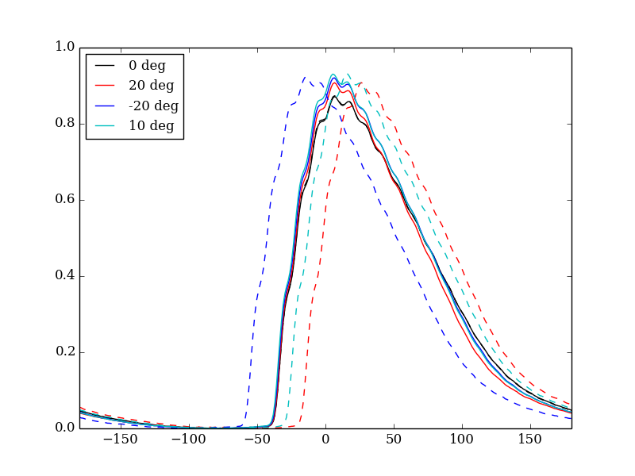
Bunch monitor profiles before/after phase jump

Slide 9
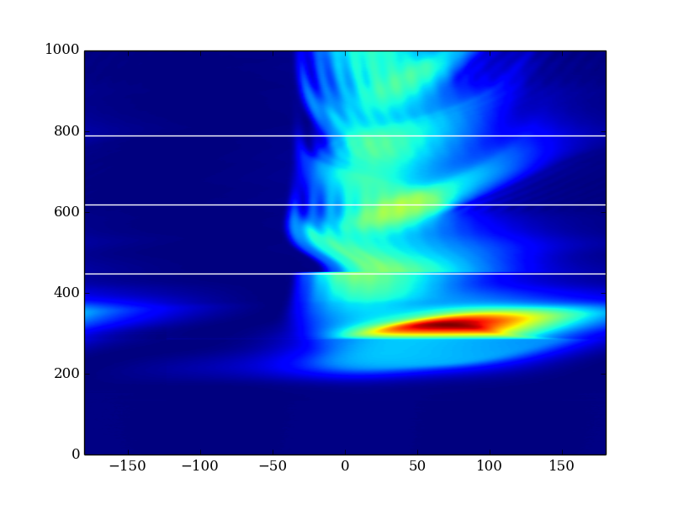
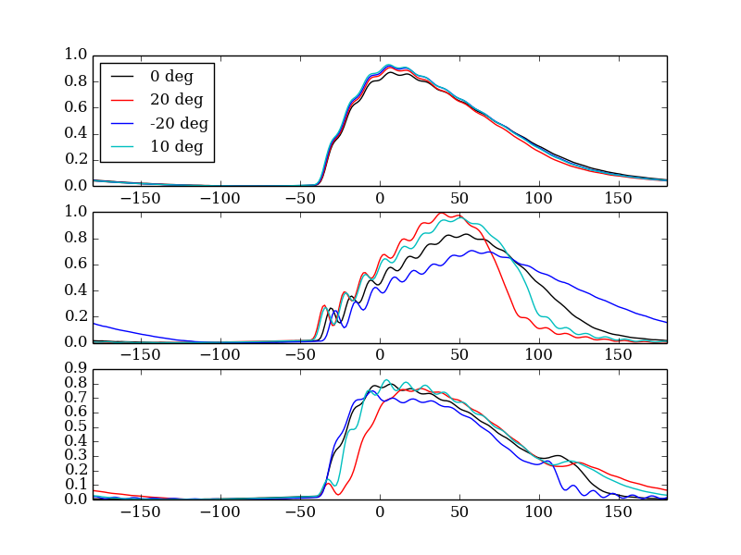
Profiles at select turns
1
3
2
2
1
1
3
The profiles look more peaked with a positive phase jump (2 and 3). However, note the difference just before the phase jump (1).

Slide 10
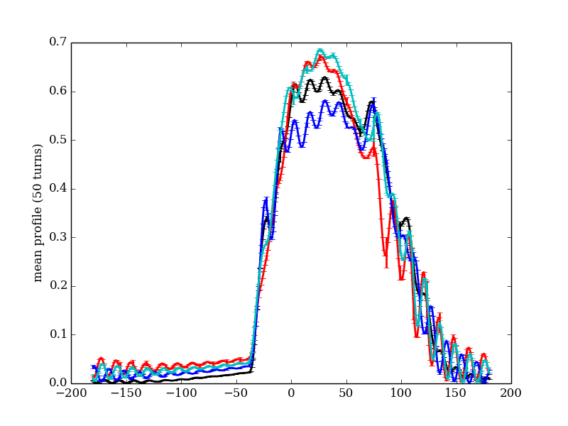
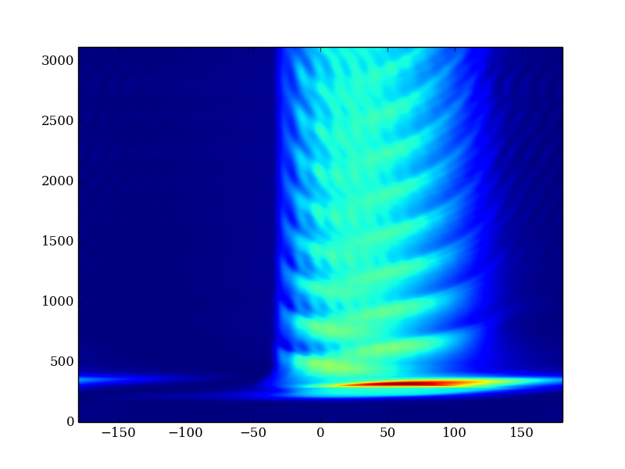
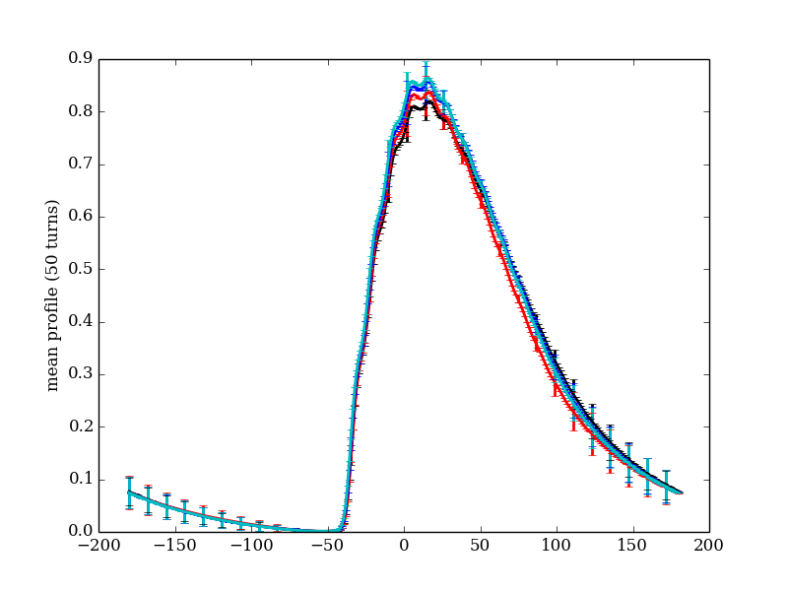
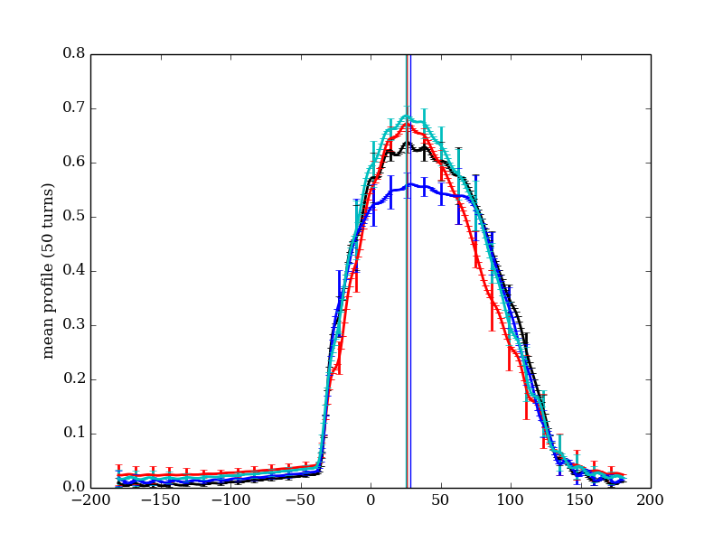
Profiles averaged over turns
Maximum at ~16 deg
Final 50 turns
<Turn 400-449> (just before jump)
Take the average of 50 or 500 profiles on consecutive turns. The error bar shows the standard deviation at each phase.
The vertical lines show the location of the maximum in the distribution over the final 500 turns. The corresponding phases range from 24.8 – 28.5 degrees.
Final 500 turns

Slide 11
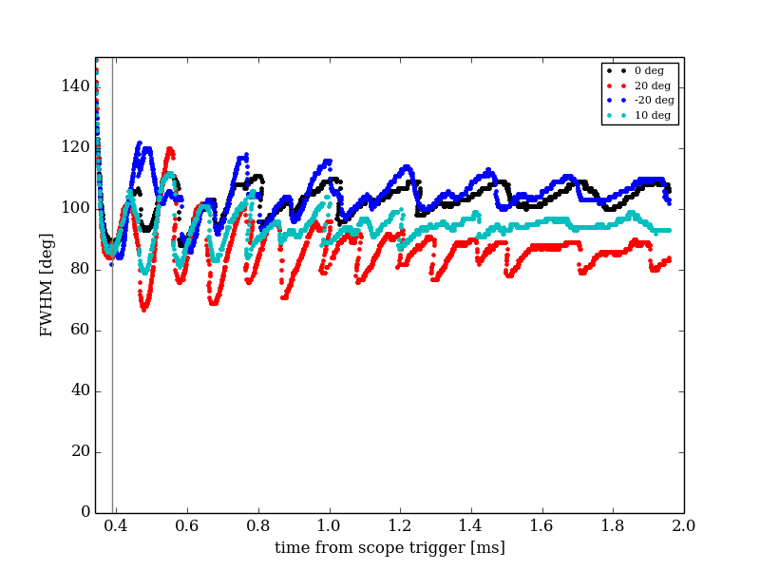
FWHM

Slide 12
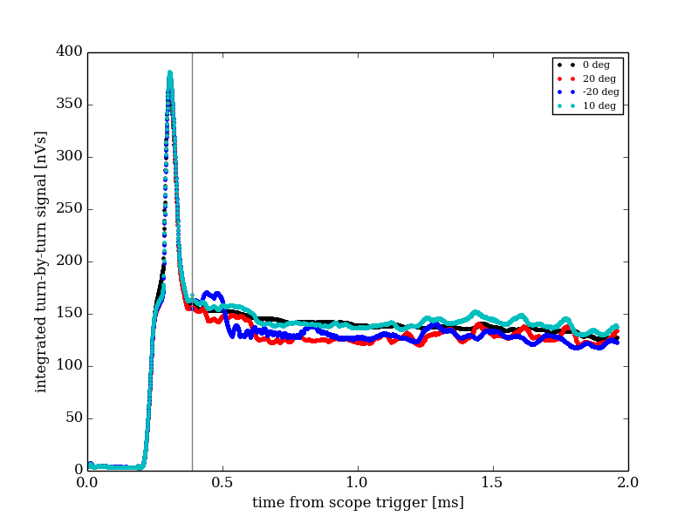
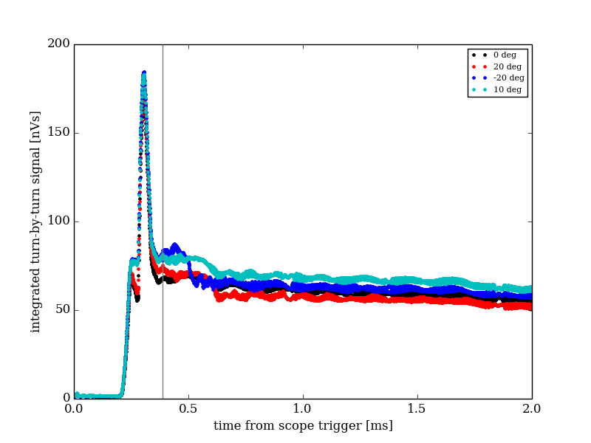
Bunch integral (first 2ms)
Phase jump
High res
Low res (same time range)

Slide 13
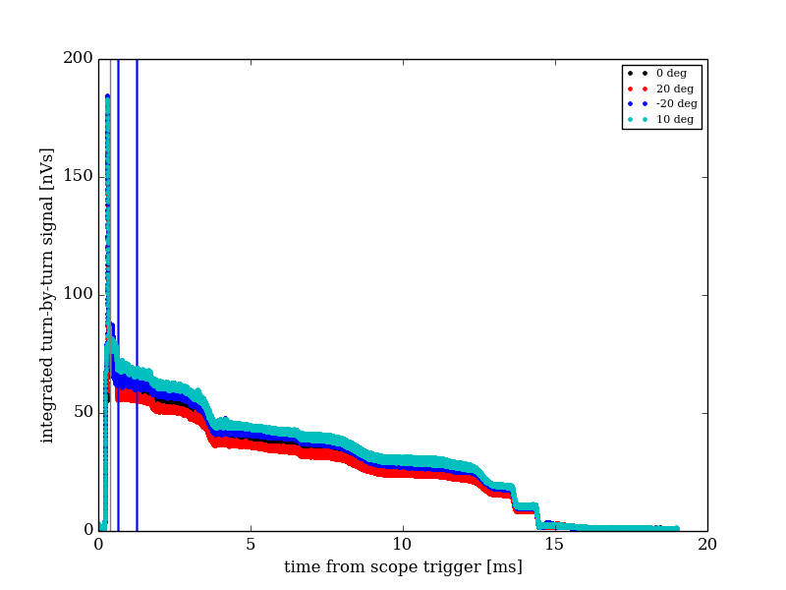
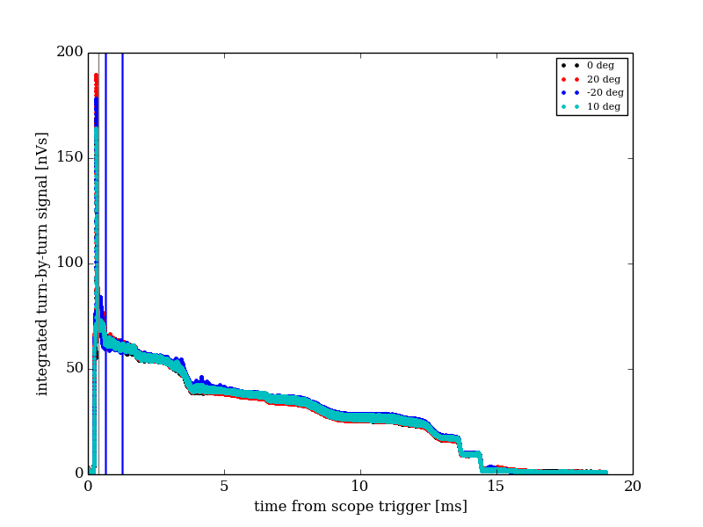
Bunch integral (full cycle)
Use mean integral in this range to establish normalization factor
Low res (all data)
Low res (normalized to baseline case)

Slide 14
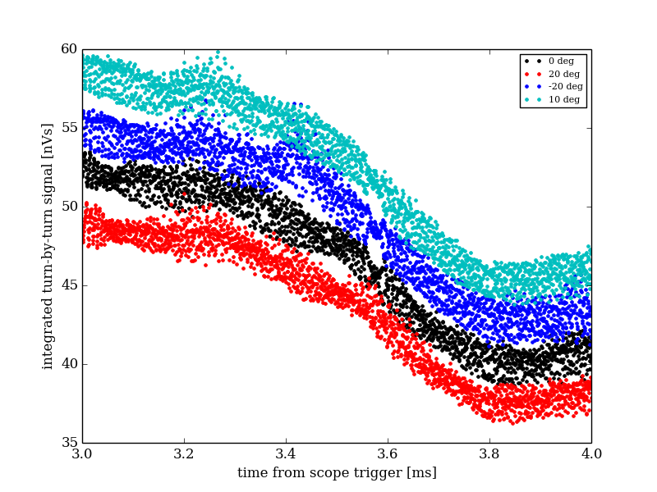
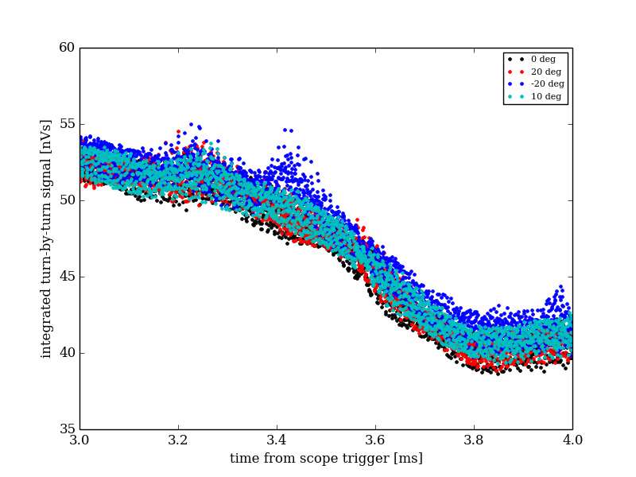
Bunch integral (first resonance crossing?)
Normalised as in previous slide
Zoom around dip at 3.5ms

Slide 15
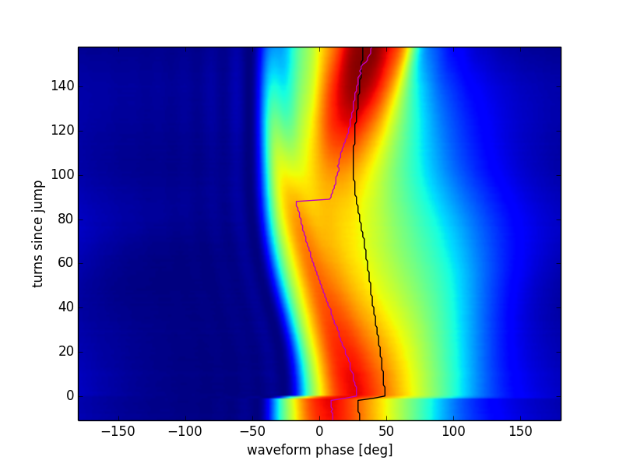
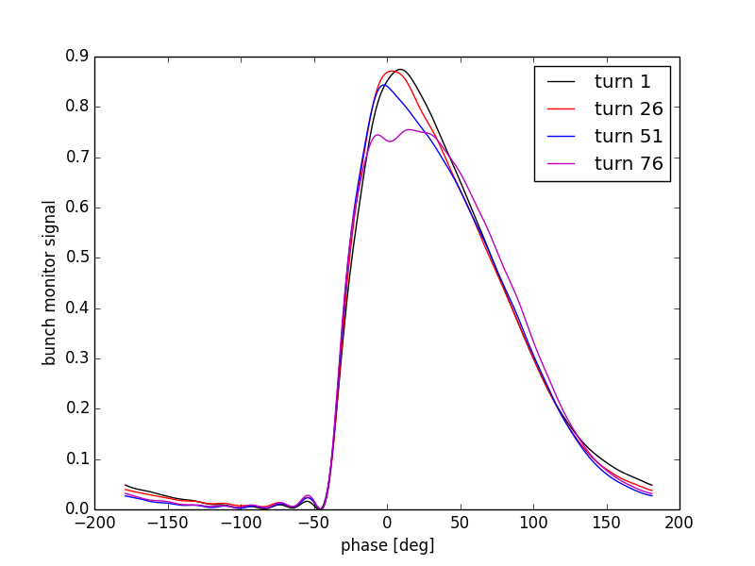
Tomography – input data
20 degree phase jump.
Magenta line: Phase at distribution maximum
Black line: Symmetric phase.
50 MHz noise removed.
Use 170 turns starting just after the phase jump in reconstruction.
This is roughly half a synchrotron oscillation.
Assume the synchronous phase is 24 deg, V = 2.69kV.

Slide 16
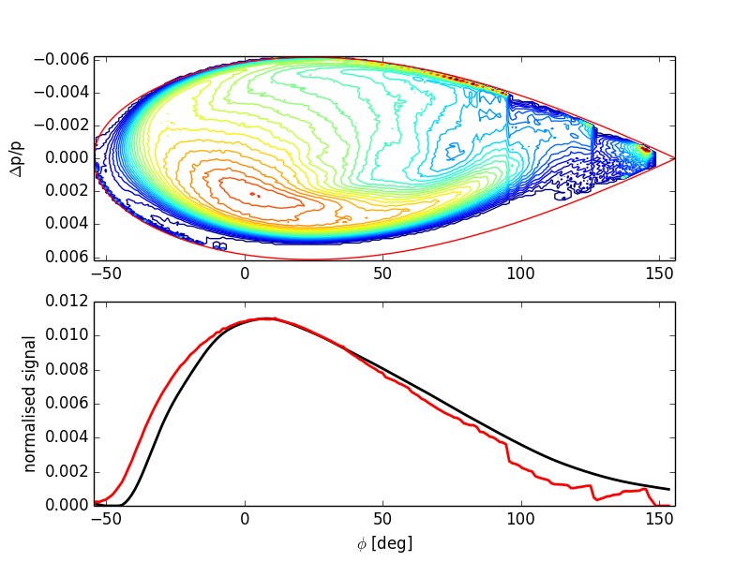
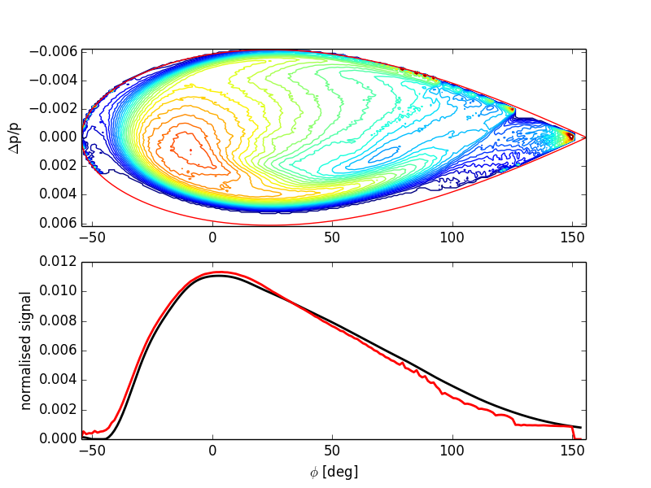
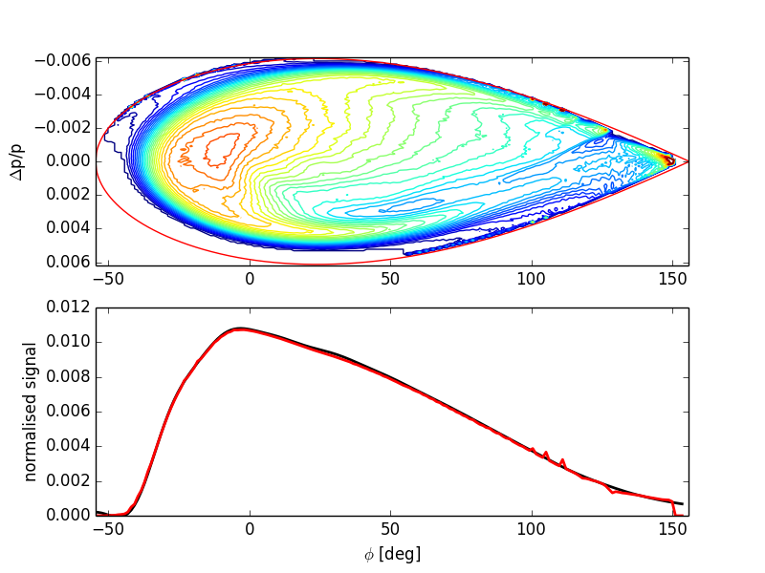
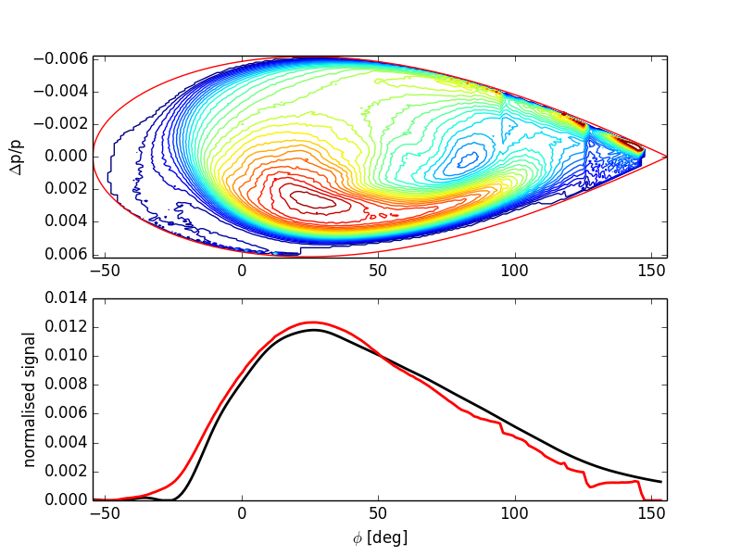
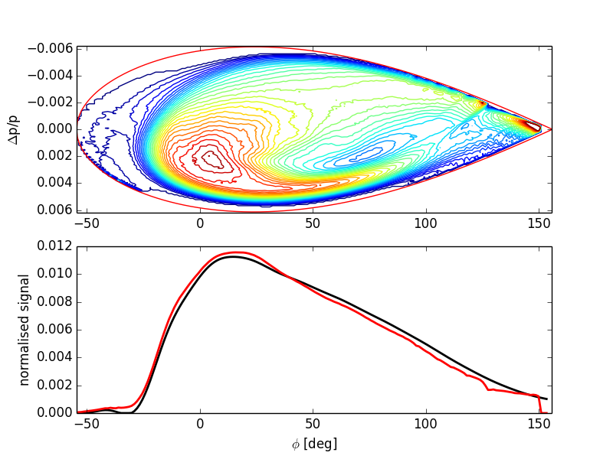
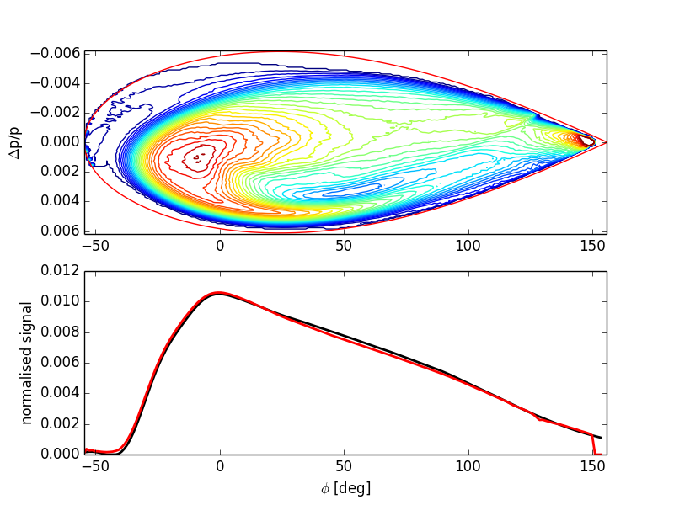
Phase space reconstruction
dp/p axis is flipped!
Turn 1 (just after phase jump)
Turn 26
Turn 51
Phase jump = 0 deg
Phase jump = 20 deg

Slide 17
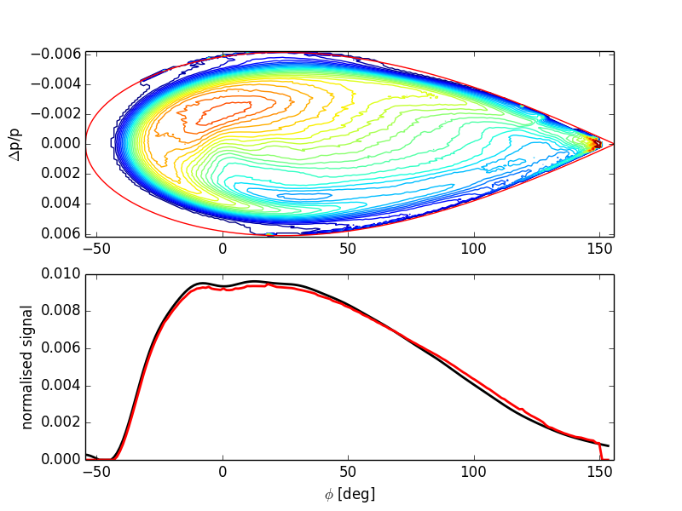
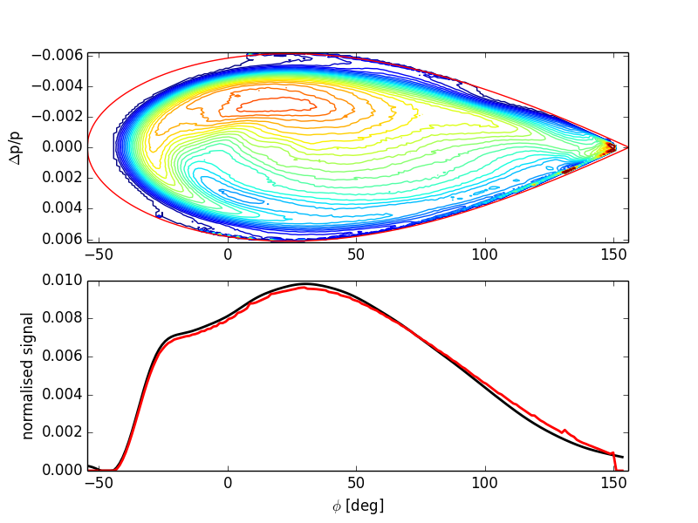
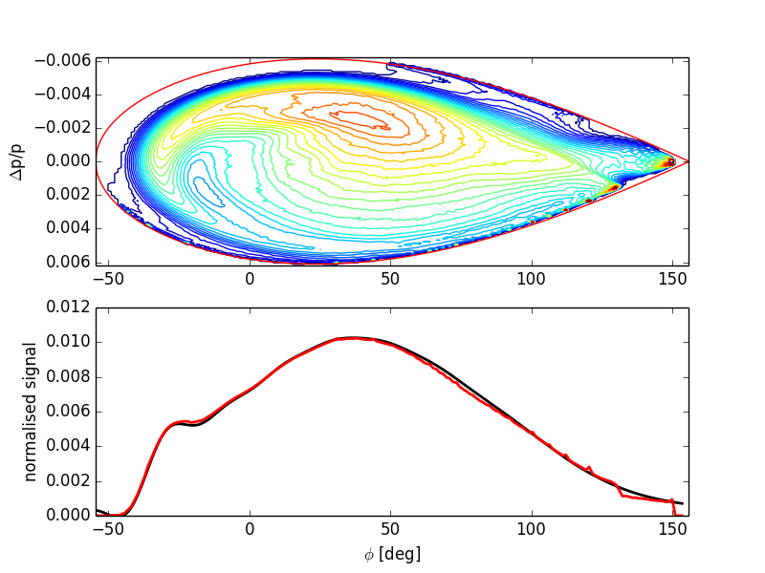
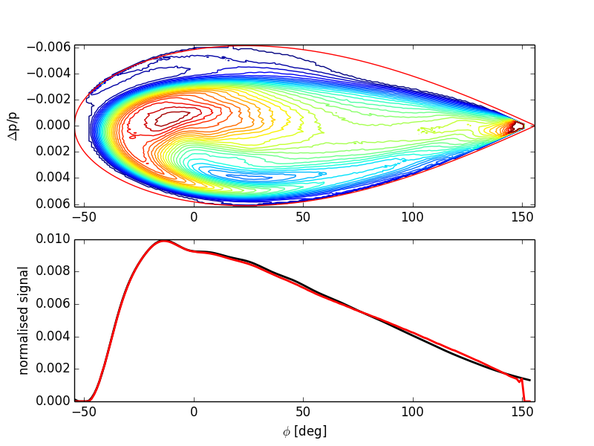
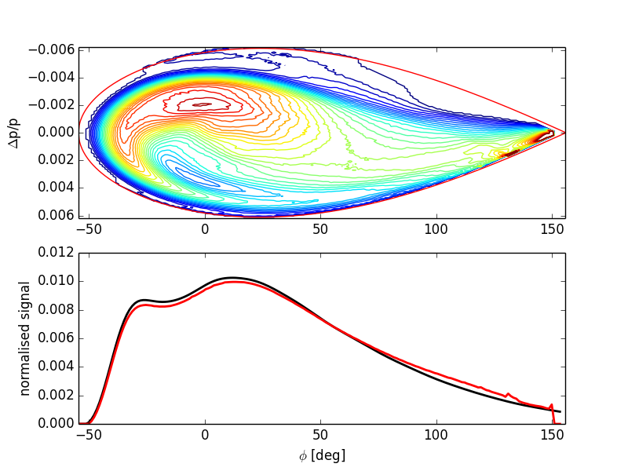
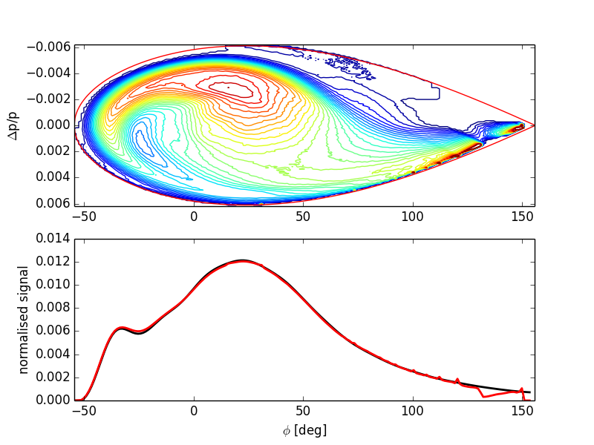
Phase space reconstruction
Turn 76
Turn 101
Turn 126
Phase jump = 0 deg
Phase jump = 20 deg

Slide 18
Location of peak just after phase jump
Phase jump applied | Phase [deg] | dp
0 | 2.82 | 0.0022
20 | 27.53 | 0.0028
-20 | -18.35 | 0.0017
10 | 12.24 | 0.0024

Slide 19
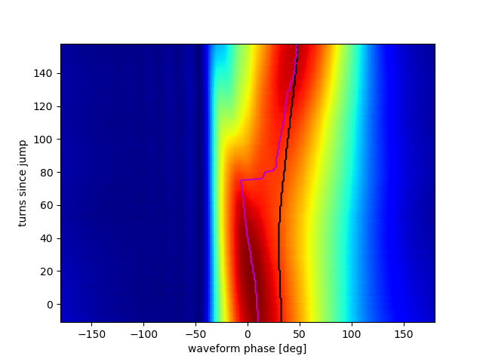
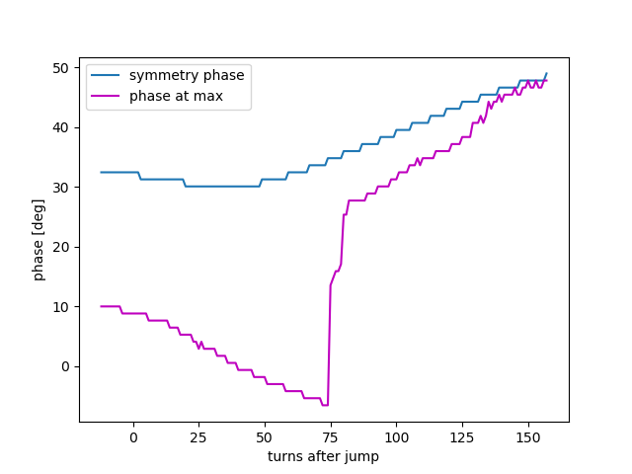
The symmetry phase minimum is consistent with where tomography indicates the bunch crosses the axis.
The location of the peak continues to move inwards as high amplitude particles reach the axis late.

